Slide 1
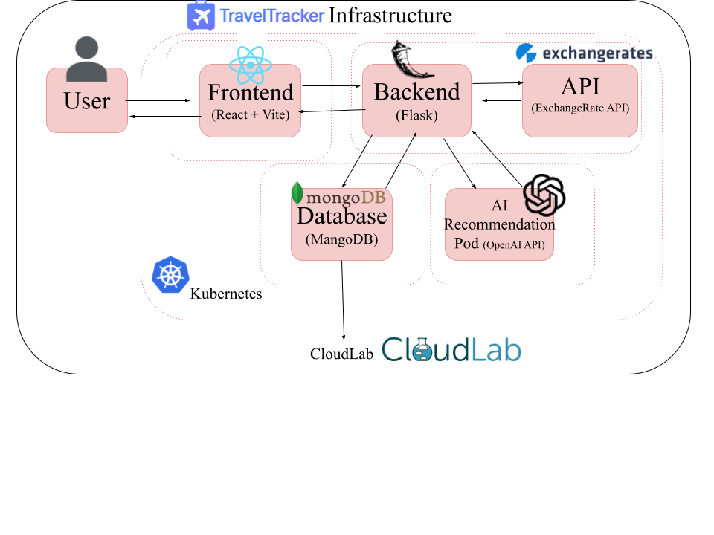
Travel Tracker – Project Overview
Olivia Tarsillo, Michael Hood, Wilfred Naraga, Nur Yavuz
Cloud-native Travel Planning Platform: budgeting, itineraries, expense tracking, and collaboration.
Transitioned from Docker Compose → Kubernetes for scalability, resilience, and production readiness.
Planned AI recommendations (hotels, activities, destinations) powered by OpenAI API.
Integrated real-time currency conversion with ExchangeRate API.
Frontend: React + Vite
Backend: Flask (Python) REST API
Database: MongoDB (StatefulSet, persistent volumes)
External Services: ExchangeRate API, OpenAI API (AI Rec Service)
Infrastructure: Kubernetes on CloudLab, with ConfigMaps, Secrets, Autoscaling

